Slide 1
Mirror API using JAVA
CodeChix Glass Workshop
Download me: http://goo.gl/Ca5AsU
+E John Feig

Slide 2
Prerequisites
Java 1.6
Any IDE or text editor
Maven
A Google account
Command-line/terminal

Slide 3
Super quick-start
download quickstart and import into IDE http://goo.gl/U1iiAx
add credentials
move credentials to src/main/java/resources/
mvn install then mvn jetty:run
browse to http://localhost:8080
in another tab, visit http://goo.gl/pJJG2V

Slide 4
Play with quick-start page
Click the buttons, see what they do

Slide 5
What is the Mirror API?
What is it?
What does it do?
How does it work?
What’s the flow?
SO MANY QUESTIONS?!?!?!

Slide 6
Topics
OAuth
Timeline
Cards
Location
Menus
Subscriptions
Contacts

Slide 7
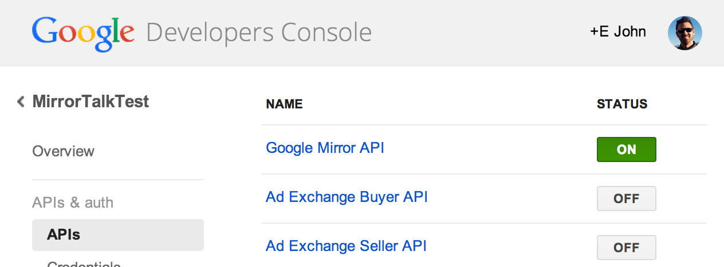
Oauth
Turn on Mirror API in Dev Console

Slide 8
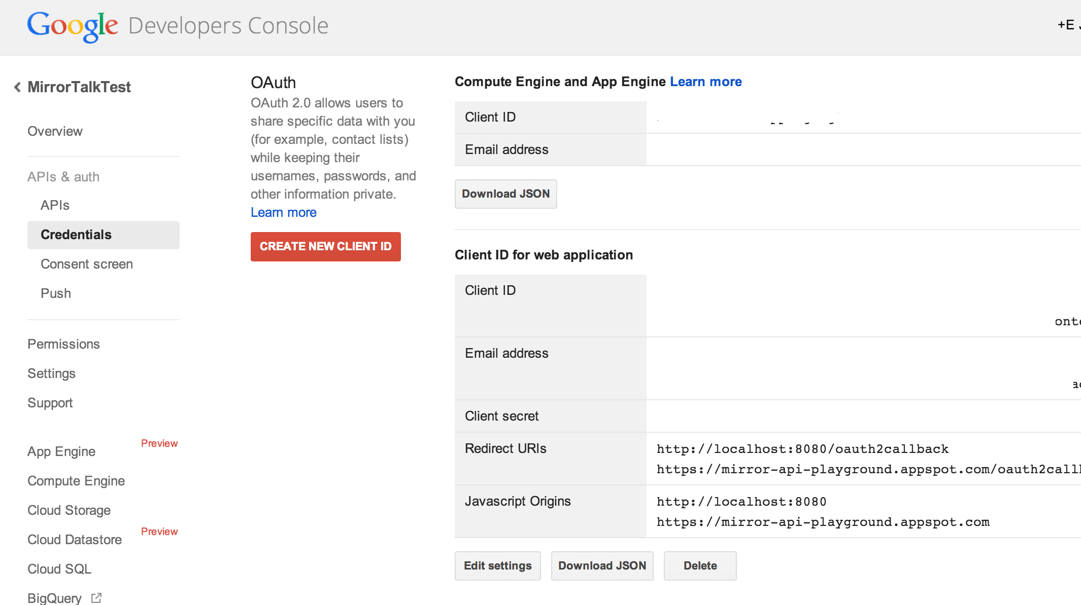
Oauth
Create Client ID

Slide 9
Oauth
update OAuth token in project:
src/main/resources/oauth.properties
// in oauth.properties...
client_id=CLIENT_ID
client_secret=CLIENT_SECRET

Slide 10
Oauth
Let’s look at some OAuth code!
AuthServlet extends HttpServlet {
void doGet(HttpServletRequest req, HttpServletResponse res) {
AuthorizationCodeFlow flow = AuthUtil.newAuthorizationCodeFlow();
GenericUrl url = flow.newAuthorizationUrl()
.setRedirectUri(WebUtil.buildUrl(req, "/oauth2callback"));
url.set("approval_prompt", "force");
res.sendRedirect(url.build());
}
}

Slide 11
Oauth
// when we get the ‘code’ back from Google, here’s what we do with it:
void doGet(HttpServletRequest req, HttpServletResponse res) {
AuthorizationCodeFlow flow = AuthUtil.newAuthorizationCodeFlow();
// exchange the code for a token
TokenResponse tokenResponse = flow.newTokenRequest(req.getParameter("code"))
.setRedirectUri(WebUtil.buildUrl(req, "/oauth2callback")).execute();
String userId = ((GoogleTokenResponse)tokenResponse).parseIdToken()
.getPayload().getUserId();
AuthUtil.setUserId(req, userId);
flow.createAndStoreCredential(tokenResponse, userId);
NewUserBootstrapper.bootstrapNewUser(req, userId);
res.sendRedirect(WebUtil.buildUrl(req, "/"));
}

Slide 12
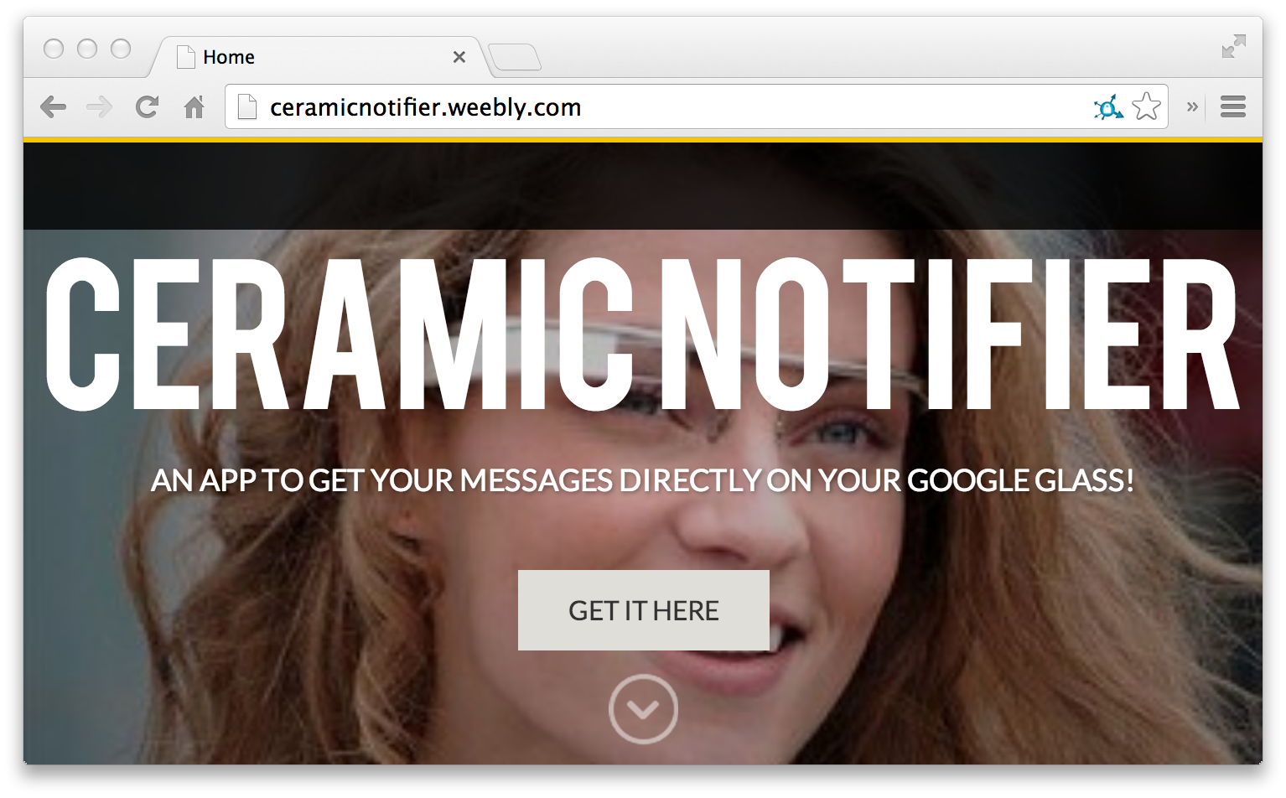
Oauth

Slide 13
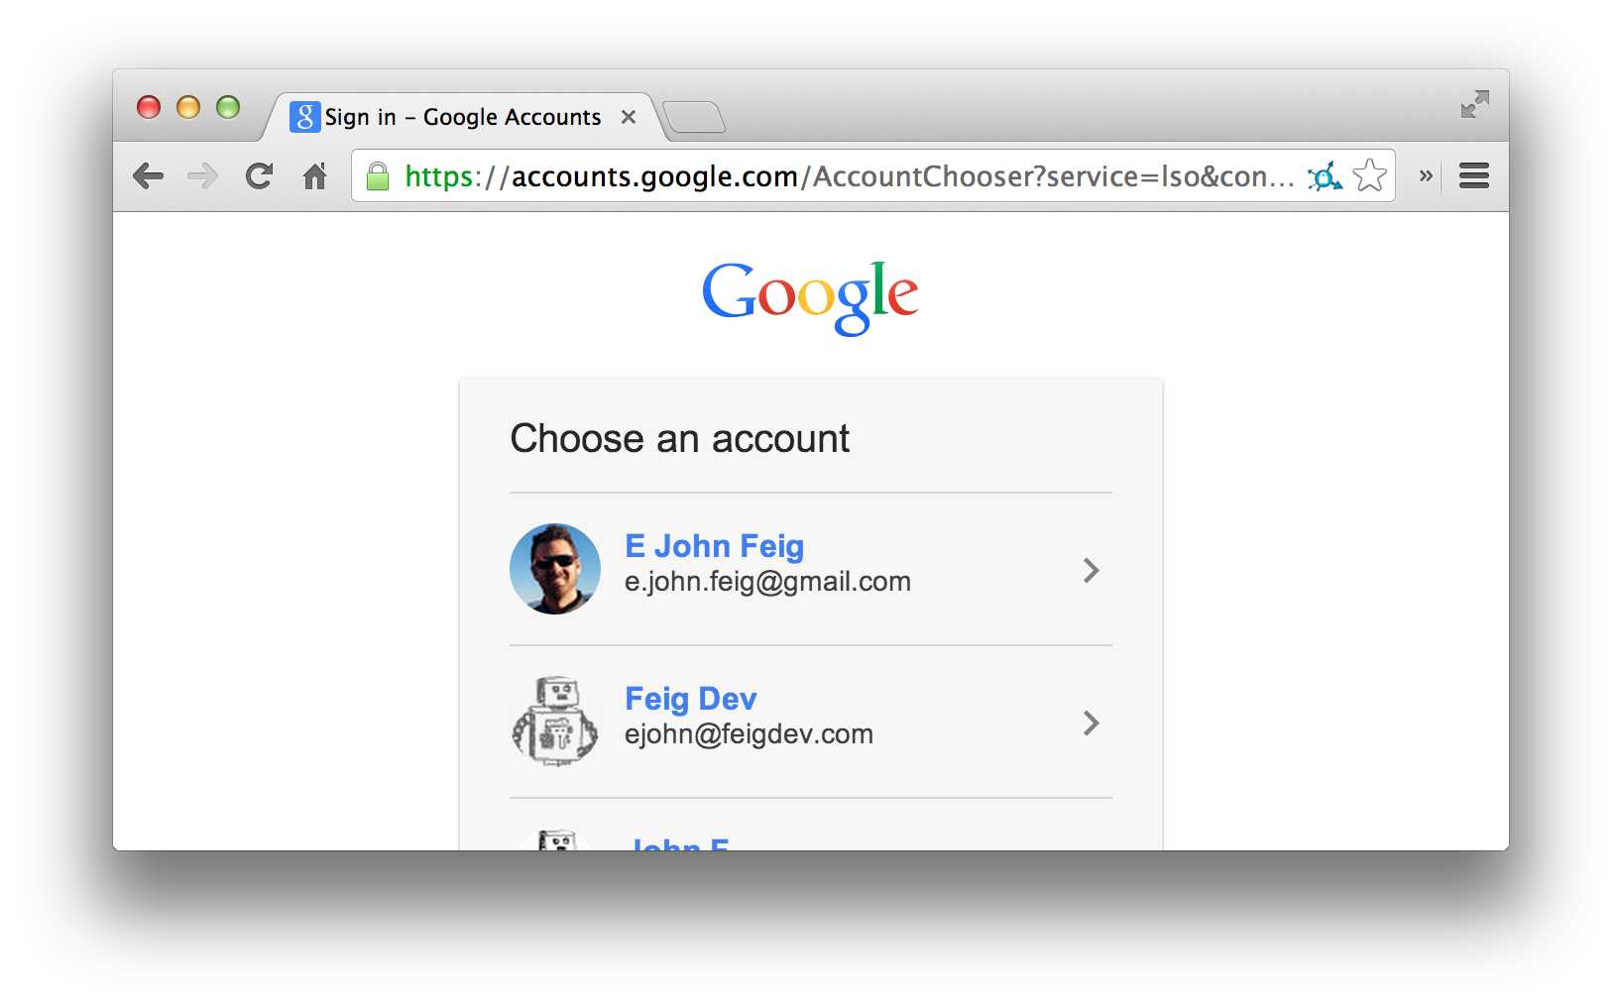
Oauth

Slide 14
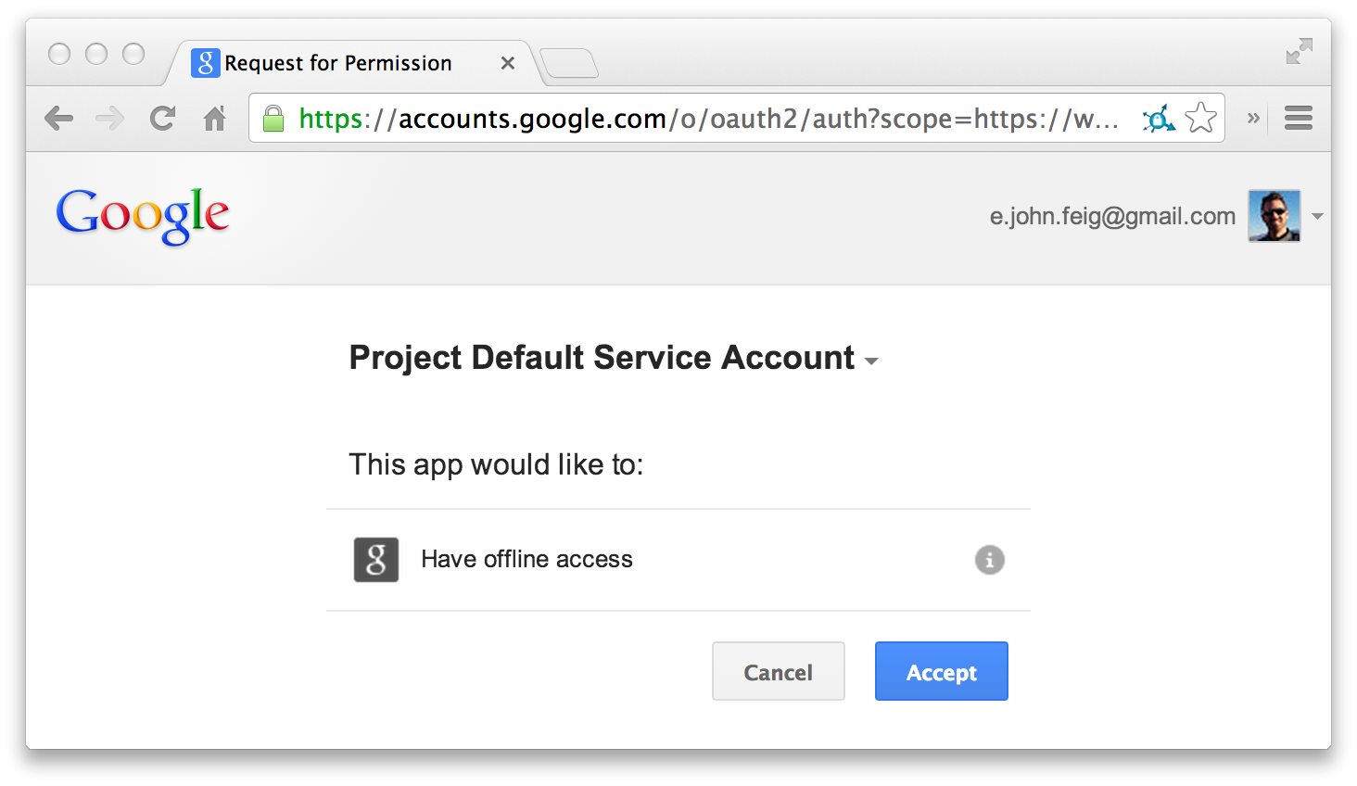
Oauth

Slide 15
Timeline and Cards
What is the Timeline?
Why a Timeline?
What are Cards?
How do I insert Cards into the Timeline?

Slide 16
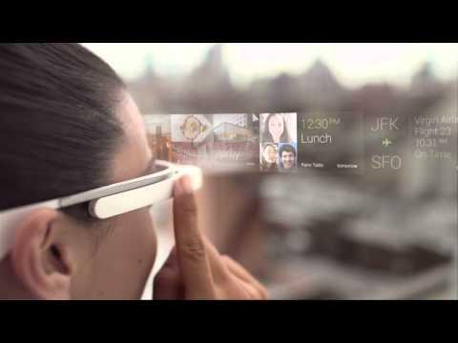
Timeline

Slide 17
Timeline
Why?
Navigational issues
Push instead of pull
Semi-ephemeral

Slide 18
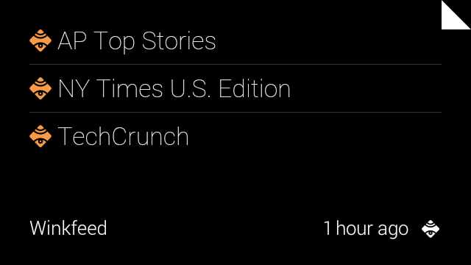
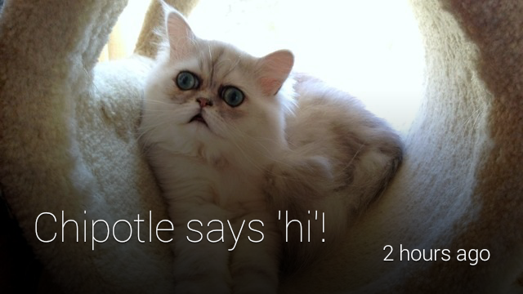
Cards

Slide 19
Bundles

Slide 20
Timeline and Cards
Getting a new Card into the Timeline
void insertTimelineItem(message, credential){
TimelineItem timelineItem = new TimelineItem();
timelineItem.setText(message);
timelineItem.setNotification(new NotificationConfig()
.setLevel("DEFAULT"));
MirrorClient.insertTimelineItem(credential,
timelineItem);
}

Slide 21
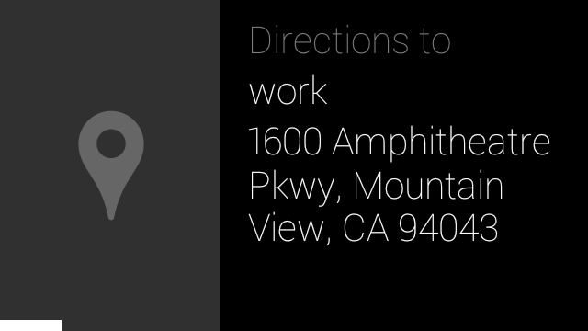
Locations
Items that you can navigate to

Slide 22
Locations
import com.google.api.services.mirror.model.Location;
void insertTimelineLocation(String address){
Location loc = new Location(); loc.setAddress(address); loc.setDisplayName(address); loc.setLatitude(location.getLatitude()); loc.setLongitude(location.getLongitude());
TimelineItem timelineItem = new TimelineItem();
timelineItem.setLocation(location);
// insert just like before
}

Slide 23
Locations
You can also subscribe for location updates from the Glass device to your service.
Location location = MirrorClient.getMirror(credential)
.locations().get(notification.getItemId()).execute();

Slide 24
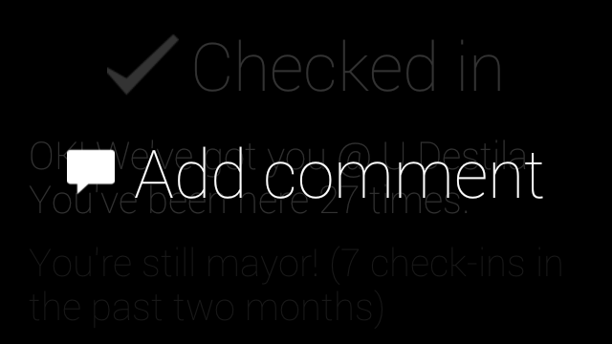
Menus
Things you can do with a Card

Slide 25
Menus
Things you can do with a Card
List<MenuItem> menus = new ArrayList<MenuItem>();
menus.add(new MenuItem().setAction("READ_ALOUD")
.setPayload("text to read aloud"));
menus.add(new MenuItem().setAction("DELETE"));

Slide 26
Subscriptions
Allows you to get updates on a Card
// Subscribe to timeline updates
Subscription subscription = MirrorClient
.insertSubscription(credential,
WebUtil.buildUrl(req, "/notify"),
userId, "timeline");

Slide 27
Subscriptions
Types of subscriptions:
“SHARE”
“REPLY”
“DELETE”
“CUSTOM” - a custom menu has been clicked
Location updates
Voice Commands

Slide 28
Subscriptions
public static Subscription insertSubscription(Credential credential, String callbackUrl, String userId, String collection) throws IOException {
Subscription subscription = new Subscription();
subscription.setCollection(collection);
subscription.setCallbackUrl(callbackUrl);
subscription.setUserToken(userId);
return getMirror(credential).subscriptions()
.insert(subscription).execute();
}

Slide 29
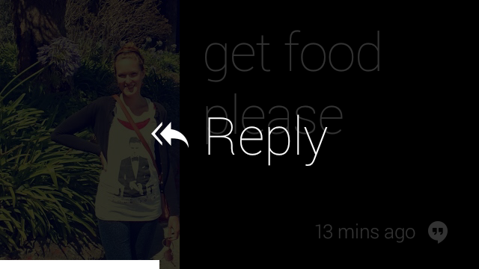
Subscriptions

Slide 30
Subscriptions
Stupid work-around for localhost subscriptions (don’t do this in production)
// https://mirrornotifications.appspot.com/forward?url=<your_callback_url>
callbackUrl = "https://mirrornotifications.appspot.com/forward?url="
+ callbackUrl;

Slide 31
Contacts
People and services that you can send data to
// Create contact
Contact starterProjectContact = new Contact();
starterProjectContact.setId(MainServlet.CONTACT_ID);
starterProjectContact.setDisplayName(MainServlet.CONTACT_NAME);
starterProjectContact.setImageUrls(Lists.newArrayList(WebUtil.buildUrl(req,
"/static/images/chipotle-tube-640x360.jpg")));
starterProjectContact.setAcceptCommands(Lists.newArrayList(
new Command().setType("TAKE_A_NOTE")));
Contact insertedContact = MirrorClient.insertContact(credential,
starterProjectContact);

Slide 32
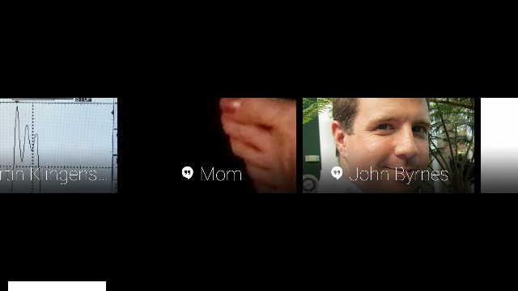
Contacts

Slide 33
Contacts
Commands that use contacts:
“POST_AN_UPDATE”
“TAKE_A_NOTE”
Sharing (requires a subscription)

Slide 34
Code
Let’s go back to the quick-start and play with it

